Slide 1
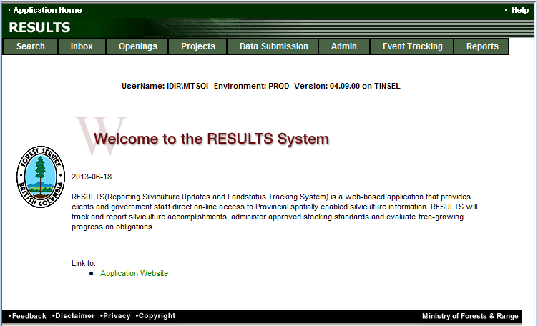
RESULTS Training
Core Module 4
Obligation Reporting
Standards Unit Modifications
Overview
Sept 2013

Slide 2
Learning Objectives
Business Guidance
Mandatory ESF
Online or ESF
Technical documentation
Mandatory SU and Site Plan Exempt Ind
Process and Rules
Help Resources

Slide 3
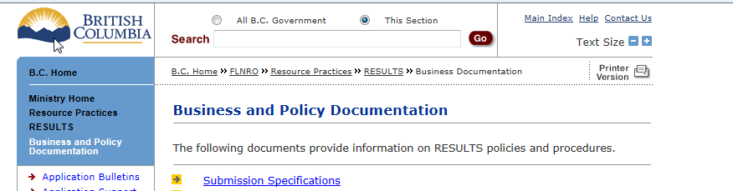
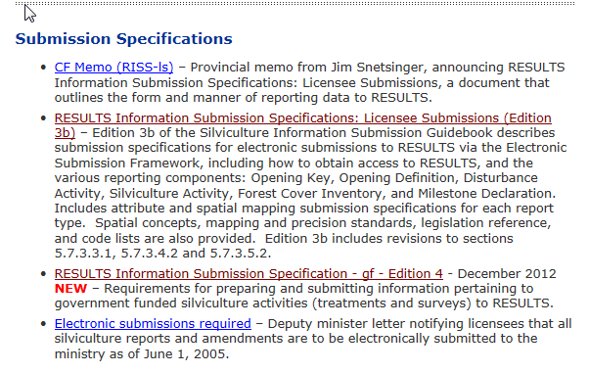
Business Guidance
http://www.for.gov.bc.ca/his/results/business.htm

Slide 4
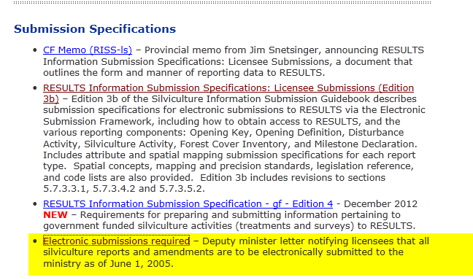
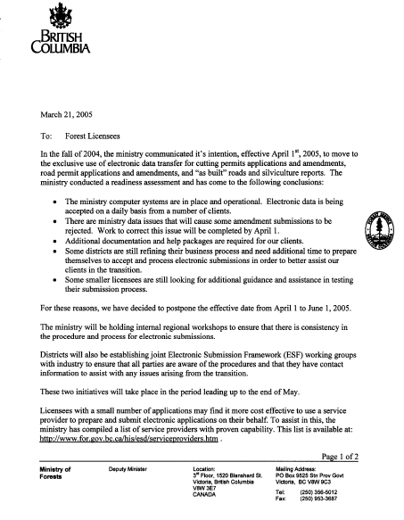
Mandatory ESF

Slide 5
Online or ESF Matrix
Submission Component | ESF | Online
Opening Definition Tenure & Site Plan Information | Yes | No Opening and Standards Unit Spatial required
SU Modifications* | Yes | Conditional ESF where there is changes to Standards Unit (additions, deletions) or changes in spatial.
Disturbance | Yes | Yes
Silviculture Activity | Yes | Yes Mandatory ESF for government funded activities (FE, JS)
Forest Cover * | Yes | No Forest Cover Spatial required
Milestone | Yes | Yes
s.108 Application | No | Yes
* Any spatial requirements must be submitted by ESF

Slide 6
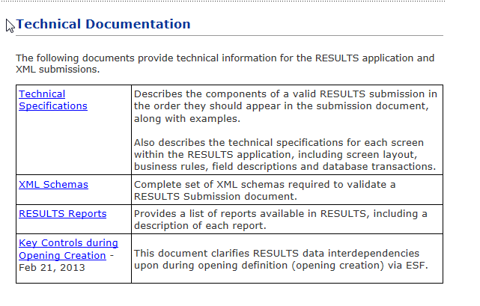
Technical Documentation References http://www.for.gov.bc.ca/his/results/techDocs.htm

Slide 7
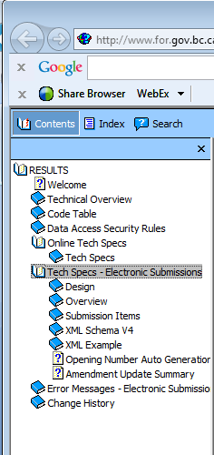
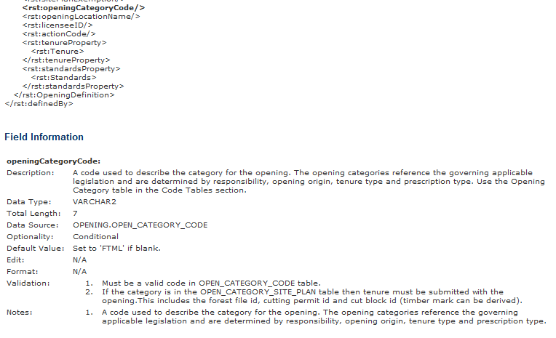
Technical Documentation ESF Schema References
http://www.for.gov.bc.ca/his/results/techDocs.htm
Tech Specs has ESF Reference with business rules and field specific edits.
Reference is by schema item.

Slide 8
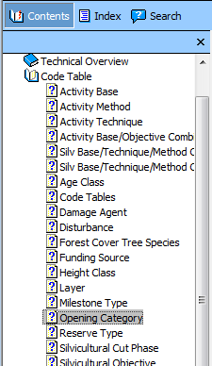
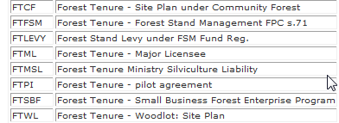
Technical Documentation Codelists http://www.for.gov.bc.ca/his/results/techDocs.htm

Slide 9
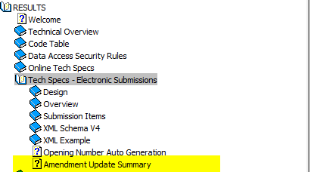
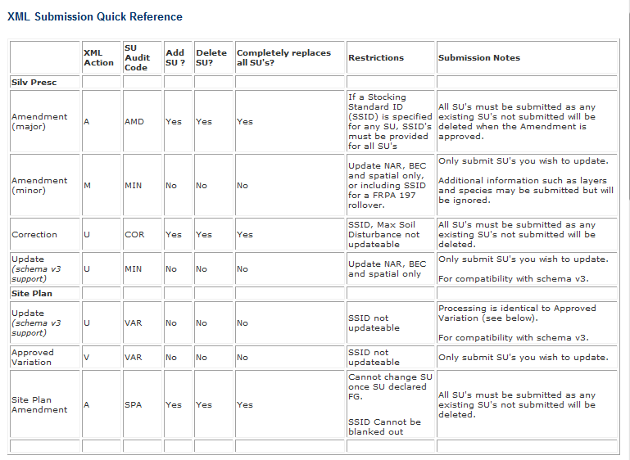
Technical Documentation SU Modifications Cheatsheet
http://www.for.gov.bc.ca/his/results/techDocs.htm
Helps explain setup for ESF portion
“A”, “U” and “V” actions with inclusion or omission of SU implies addition or removal of SUs!

Slide 10
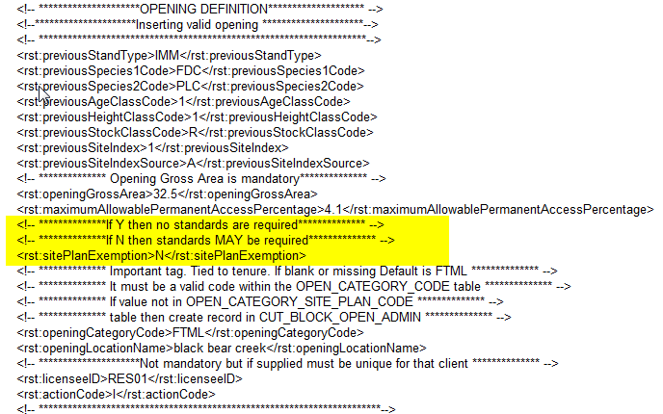
SU Requirement & Role of Site Plan Exempt Ind
http://www.for.gov.bc.ca/his/results/Key%20Controls%20during%20Opening%20Creation-Feb%2021%202013.pdf
All New Openings via ESF must have at least ONE Standards Unit in the Opening Definition
Rst: sitePlanExempt is an indicator used by RESULTS to determine if Standards Unit is:
  a silviculture prescription “Y” – full stocking standards provided ; OR
  a site plan “N” – an approved standards regime ID authorized by submitter is provided.

Slide 11


RESULTS - Process
SU Modification – two methods
Online Application (attribute only¹)
Silviculture Prescription
Site Plan
ESF (attribute and spatial)
Type | ESF Action Code | Audit Event Action
Silv Prescription
Correction | U | COR Correction
Minor | M | MIN Amended Minor
S197 | M² | S197 Section 197
Major Amendment | A | AMD Amended
Site Plan
Approved Variation | V | VAR Variation
Site Plan Amendment | A | SPA Site Plan Amendment
¹ Online no spatial changes allowed
²197 subject to pre-condition in FSPTS use of SS ID associated with FSP with 197 Election Box Checked.

Slide 12
RESULTS –ESF Submission
(must adhere to rules)
Rules are based on when the record was created
Did it have existing spatial (after RESULTS Opening Spatial Conversion creation date 2005-04-01)
For desired Action, must ensure that rules are followed.
Examples:
Correction, Major Amendments, Site Plan Amendment – all SUs must be submitted with the required intended corrections/amendment, any existing SUs not submitted will be deleted.
Minor & Approved Variation – can only submit the SU you intend to update
See technical documentation amendment matrix for Amendment Update Summary

Slide 13
RESULTS –Spatial Rules
Spatial Rules
Not required if Opening Approved (Creation date) is before 2003-12-01 RESULT Production release date
Not required if Spatial information exist and was prior to 2005-04-01 (RESULTS Opening Spatial Conversion)
Not Required for Minor Amendment when only BEC and NAR is updated.
Not required if not specified in Opening Spatial Requirement
Current requirements for spatial is in Opening Spatial Requirement: FTML, FTLEVY, FTFSM, FTSBF, FFTFLTC, FFTITSL, FTMSL.
Where amendments impact location/shape of SU boundaries, document must be provided with spatial data

Slide 14
Standards Unit – Silviculture Prescription
Correction
  Intended to correct opening SUs entered during paper-based data entry (records pre-mandatory ESF prior to June 1, 2005)
  Corrections are to reflect legal approved documents that exists.
  Older records do not have online SP Maps (unless converted through RESULTS Opening Spatial Conversion process) and therefore making changes not require spatial; but you can always include (but then must be via ESF)

Slide 15
Standards Unit – Silviculture Prescription
Minor Amendment
  Intended for making area adjustments based on better information from field surveys.
Silviculture Prescription Amendment (requiring approval)
  Requiring changes to silviculture prescription.
FRPA s.197
  S197 rollover requires no approval required as it has been already approved under FSP.

Slide 16
Standards Unit – Site Plan
Approved Variation
  Intended for changes to stocking standards based on approved variations as per Forest Stewardship Plan.
Site Plan Amendment (no approval required)
  Amendment to site plans – can add, delete or modify Standard Unit information and SS ID.
FRPA s.197
  S197 rollover requires no approval required as it has been already approved under FSP.

Slide 17
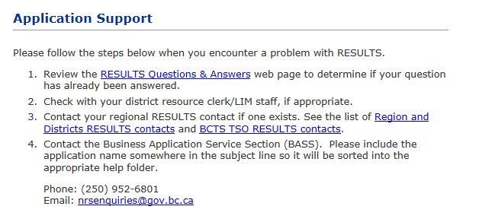
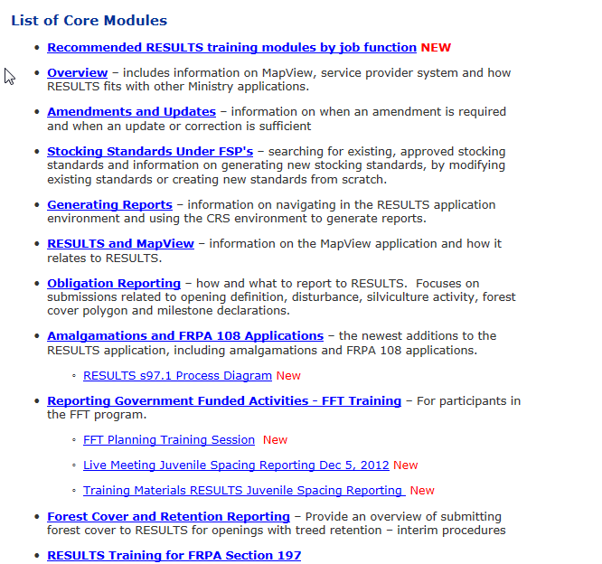
Help Resources
http://www.for.gov.bc.ca/his/results/support.htm
http://www.for.gov.bc.ca/his/results/training/index.htm
E-Stand Enhancement

